Slide 1
NLP

Slide 2
Introduction to NLP
K-Nearest Neighbors

Slide 3
K-Nearest Neighbor Classifier
Non-parametric classifier
Keeps all training examples
Find k examples that are most similar to the new document (“neighbor” documents)
Assign the category that is most common in these neighbor documents (neighbors vote for the category)
Can be improved by considering the distance of a neighbor ( A closer neighbor has more influence)

Slide 4
Example of K-NN Classifier
(k=4)
(k=1)
?

Slide 5
k-NN Demo
http://sleepyheads.jp/apps/knn/knn.html

Slide 6
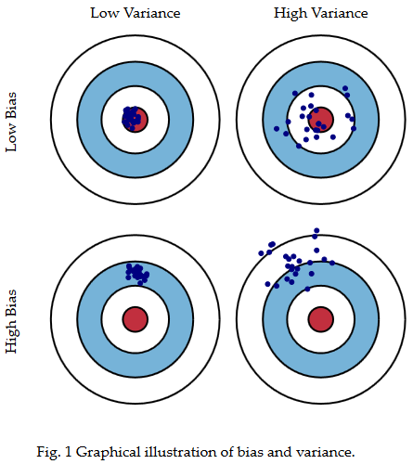
Bias-Variance Tradeoff
http://scott.fortmann-roe.com/docs/BiasVariance.html

Slide 7
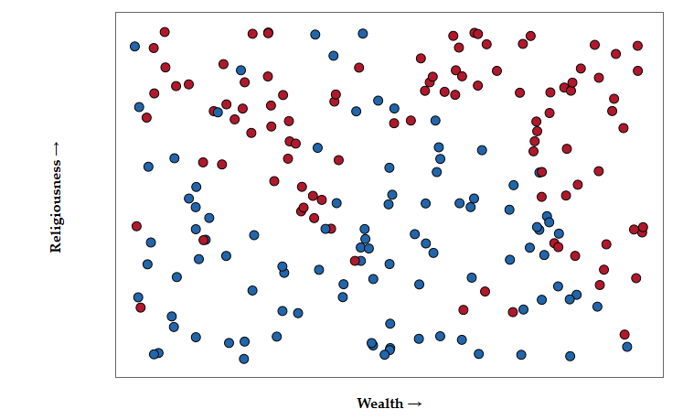
Example
http://scott.fortmann-roe.com/docs/BiasVariance.html

Slide 8
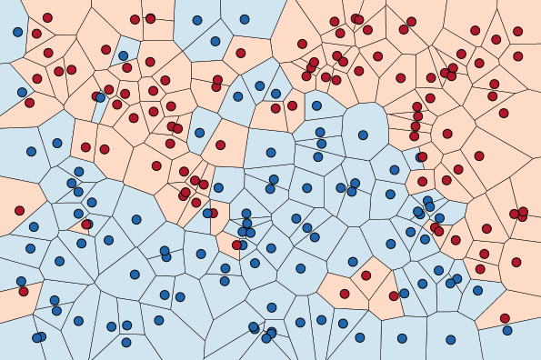
Example
http://scott.fortmann-roe.com/docs/BiasVariance.html

Slide 9
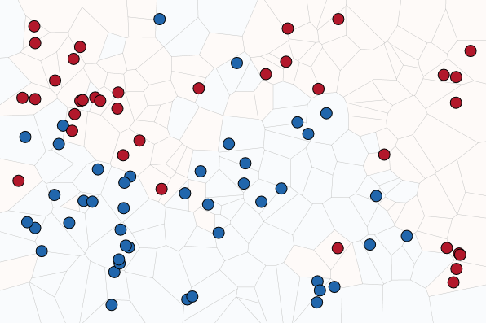
Example
http://scott.fortmann-roe.com/docs/BiasVariance.html

Slide 10

Example (n=1)
At small k's the jaggedness and islands are signs of variance.
http://scott.fortmann-roe.com/docs/BiasVariance.html

Slide 11
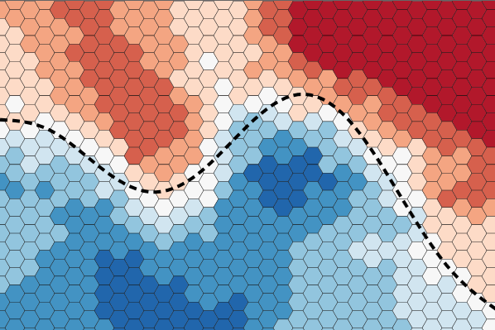
Example (n=15)
http://scott.fortmann-roe.com/docs/BiasVariance.html

Slide 12
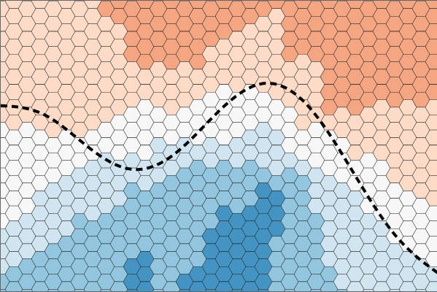
Example (n=65)
increasing k will decrease variance and increase bias
http://scott.fortmann-roe.com/docs/BiasVariance.html

Slide 13
K-Nearest Neighbor Classifier
Advantages
No training needed
Can be applied to any distance measure and document representation
Empirically effective
Disadvantages
Finding nearest neighbors has high time complexity
Imprecise when the number of examples is small, which is often true in high-dimensional spaces (neighbors cannot be trusted)

Slide 14
NLP

